Slide 1


The ThermoVacc
PREPARED BY AADITYA SHAH, KABIR PUNJWANI, AVYA GUPTA

Slide 2







PROBLEM
problem
Difficulties in maintaining the temperature of vaccines in their optimal range while being transported.

Slide 3

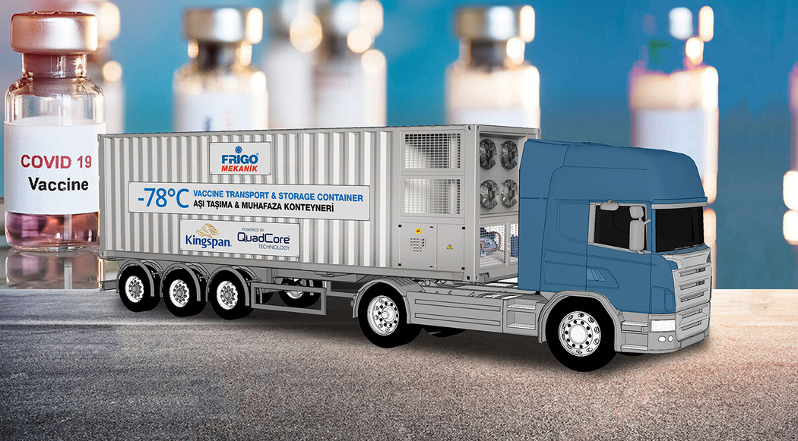
Big
Picture
Cold chain equipment that is not compatible with WHO–UNICEF product information sheets (PIS) cannot ensure the storage temperatures required for different types of vaccines. Moreover, if not well maintained, PIS-compatible equipment may malfunction and may put vaccines at risk of exposure to unacceptable temperatures. The World Health Organization reports over 50% vaccine wastage around the world.

Slide 4


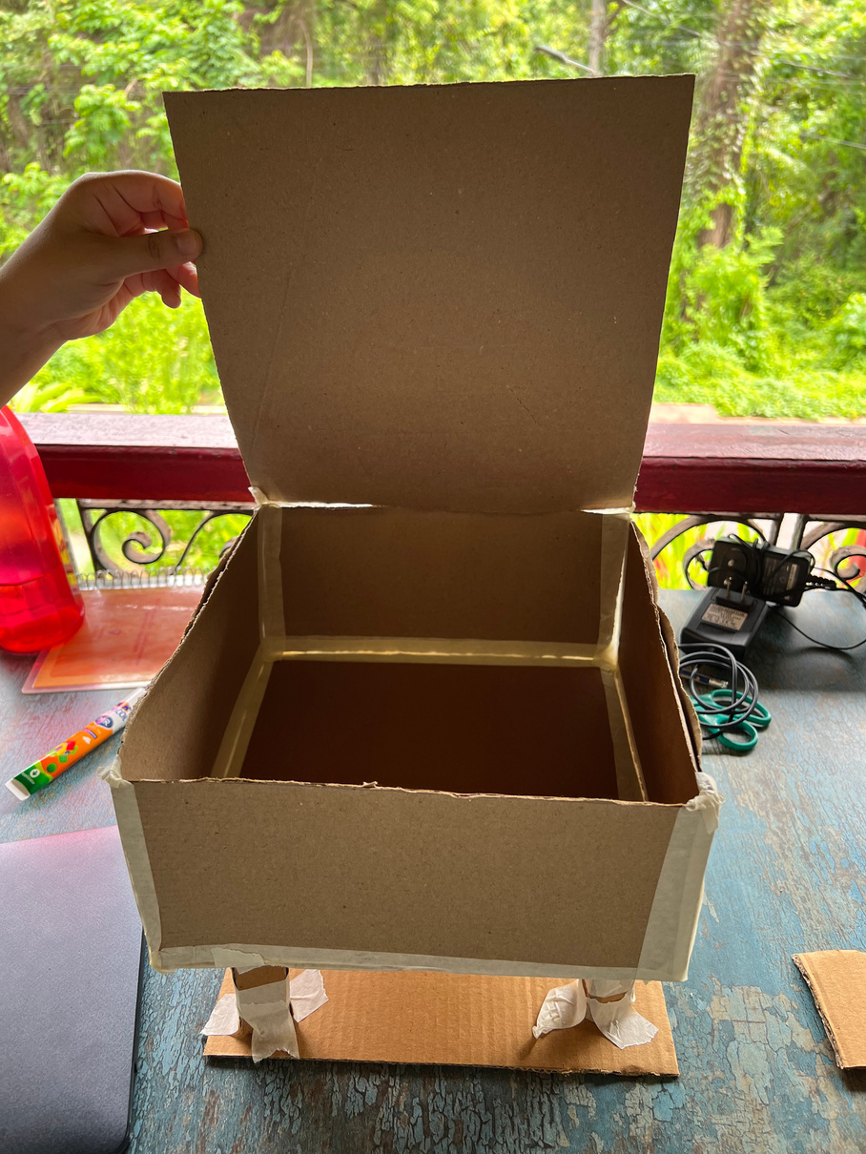
1st Prototype: The first prototype is a paper prototype made out of foam board. This prototype gave us an idea of the dimensions required for our icebox and the placement of the peltier blocks and heatsinks. We initially thought of making the legs of our icebox with wood but then changed plans and switched to PVC pipes
ITERATIONS
of
SOLUTION

Slide 5
2nd Prototype: the second prototype is the thermocol icebox. We cut out the large thermocol box into a smaller one using the dimensions of the paper prototype and attached 4 peltier blocks in a parallel circuitry with 1 breadboard and a battery. The main issue that we faced with this iteration is that the battery was not enough to power the 4 peltiers - it worked momentarily but ran out very quickly.
3rd Prototype: the third prototype was aimed at solving the issue of the battery. We decided to use a battery only for the temperature sensor and to power the arduino. For the pelteirs we used the mains - an AC to DC convertor. We also added relays to the circuit because we were using mains.
4th Prototype: in the fourth prototype we changed our breadboard and used a larger one for a cleaner looking circuit. We reduced the number of peltiers to 3 because our project wasn’t working with 4 as 2 of the peltiers had stopped working.
5th Prototype: We were facing issues with the peltiers because the heating effect was overpowering the cooling effect despite the heatsinks. We decided to add a fan so that it would further drive out the heat and so counteract the overheating.

Slide 6
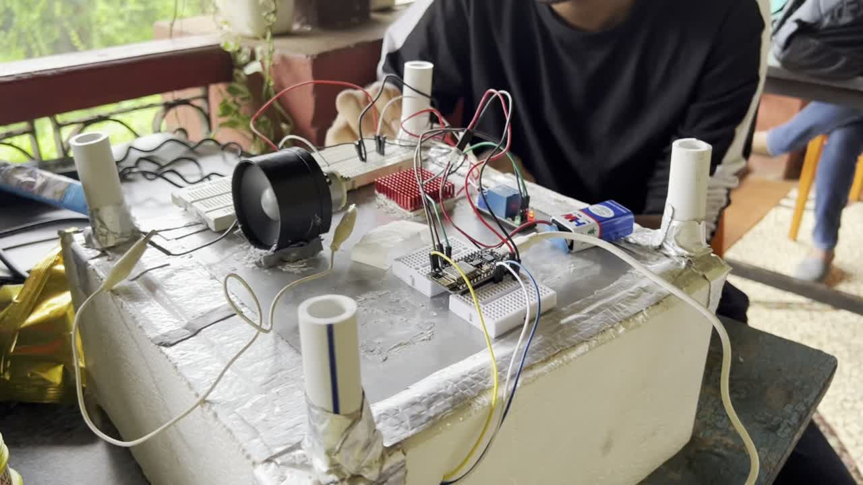
FINAL
PRODUCT

